Slide 1
3 Axis Pin Development Update
Week #3

Slide 2
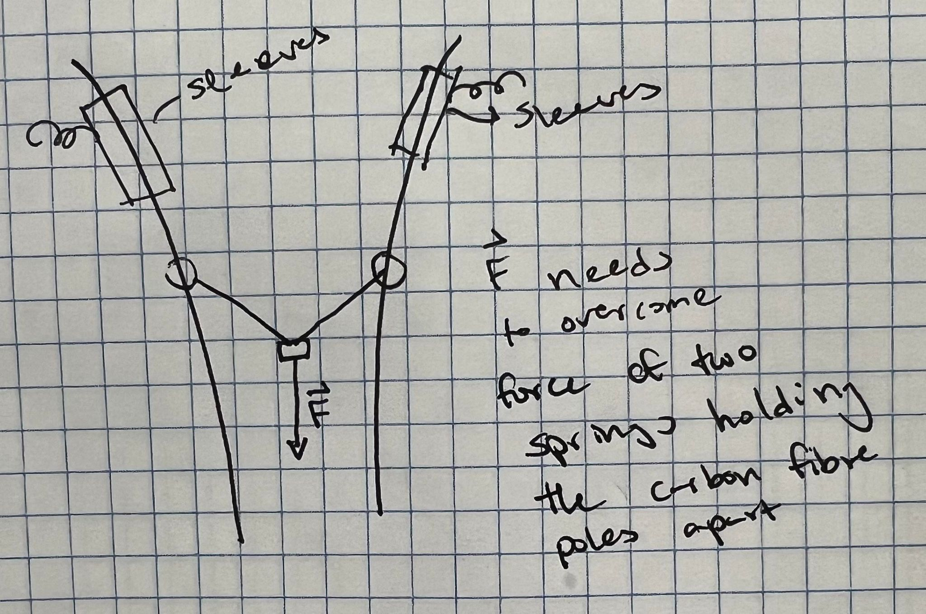
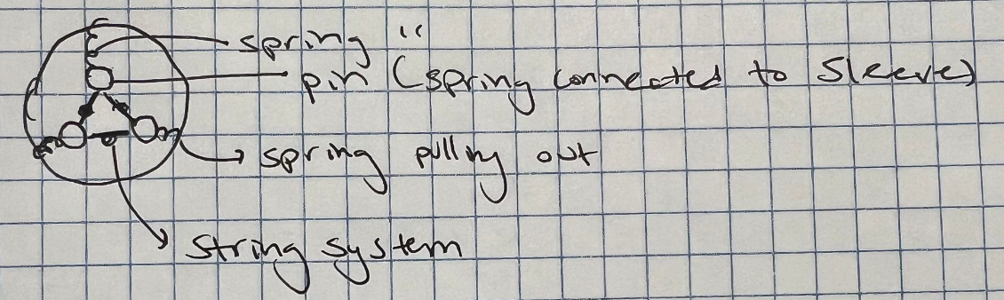

Slide 3
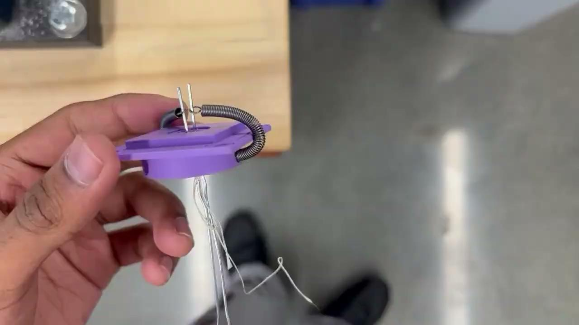
Problems So Far…
Need ‘wider coupling’ for horizontal translation
Too many degrees of freedom (want to restrict to 3)
1 vertical, 2 rotation

Slide 4
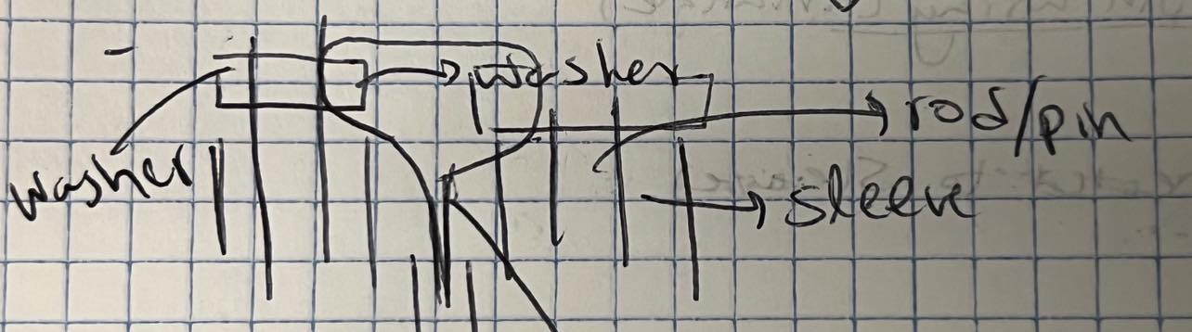
More Ideas…
Connect spring to sleeve above mount

Slide 5
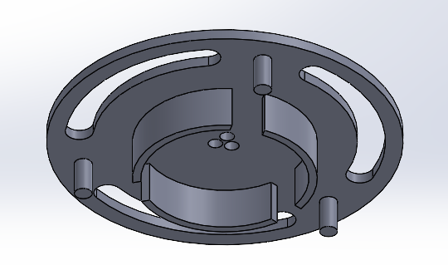
New Prototype?
Need ‘wider coupling’ for horizontal translation
Too many degrees of freedom (want to restrict to 3)
1 vertical, 2 rotation

Slide 6
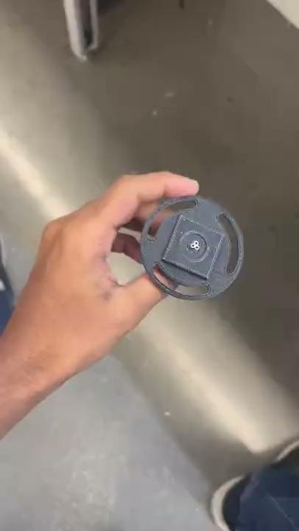
Test…ish

Slide 7
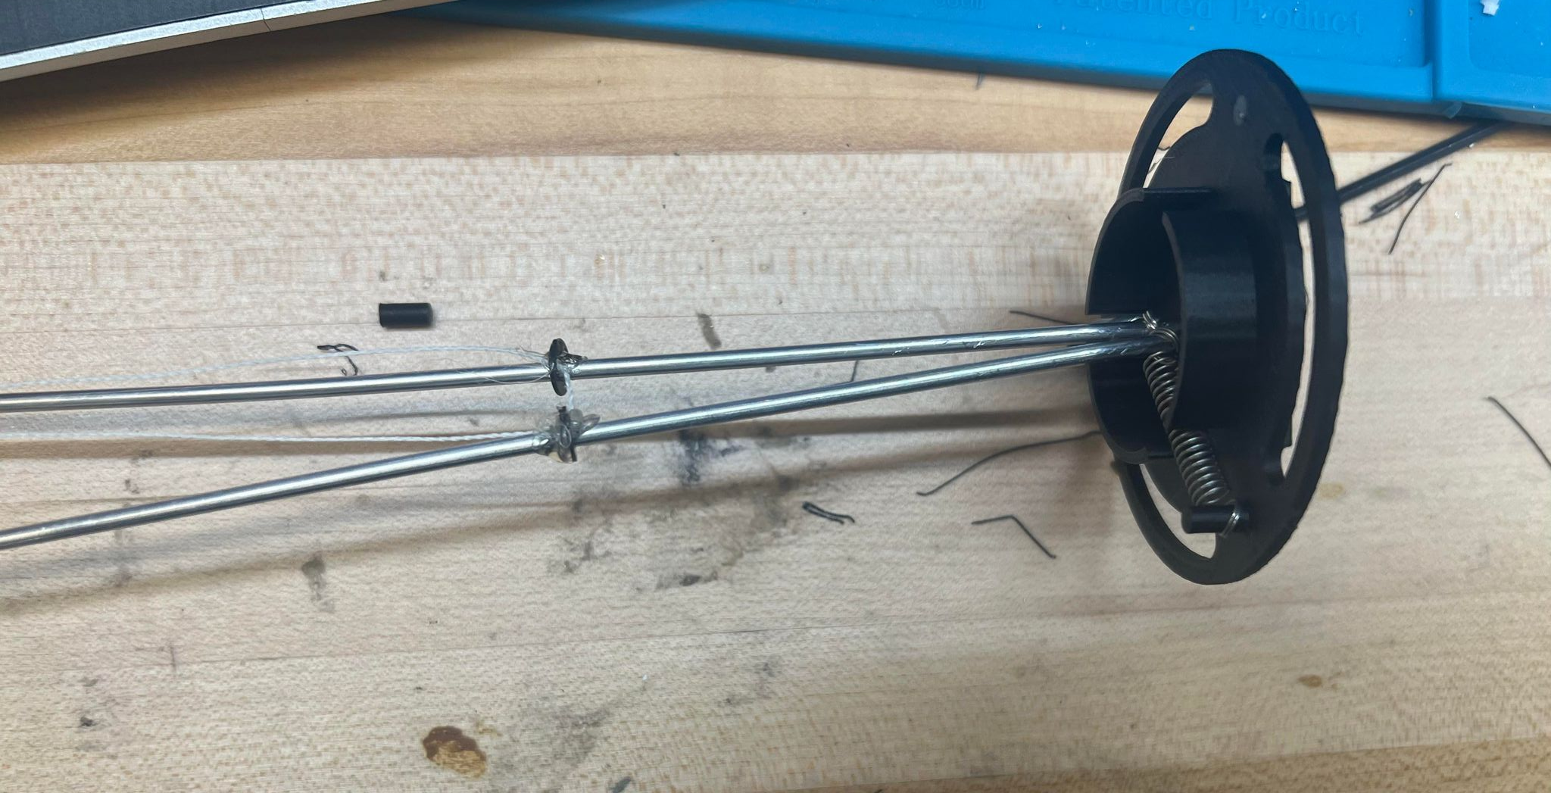
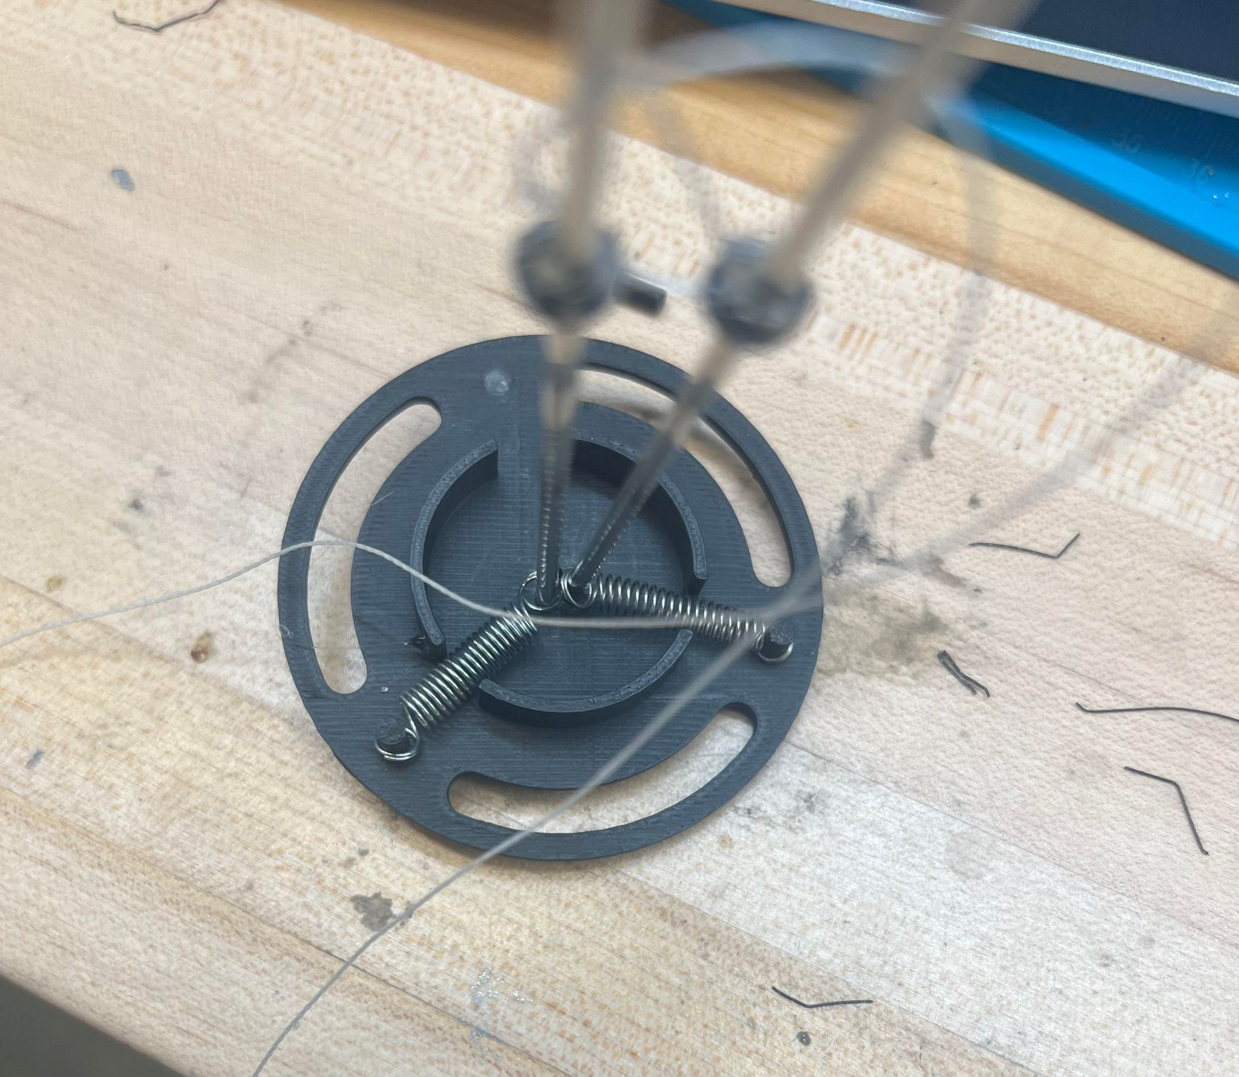
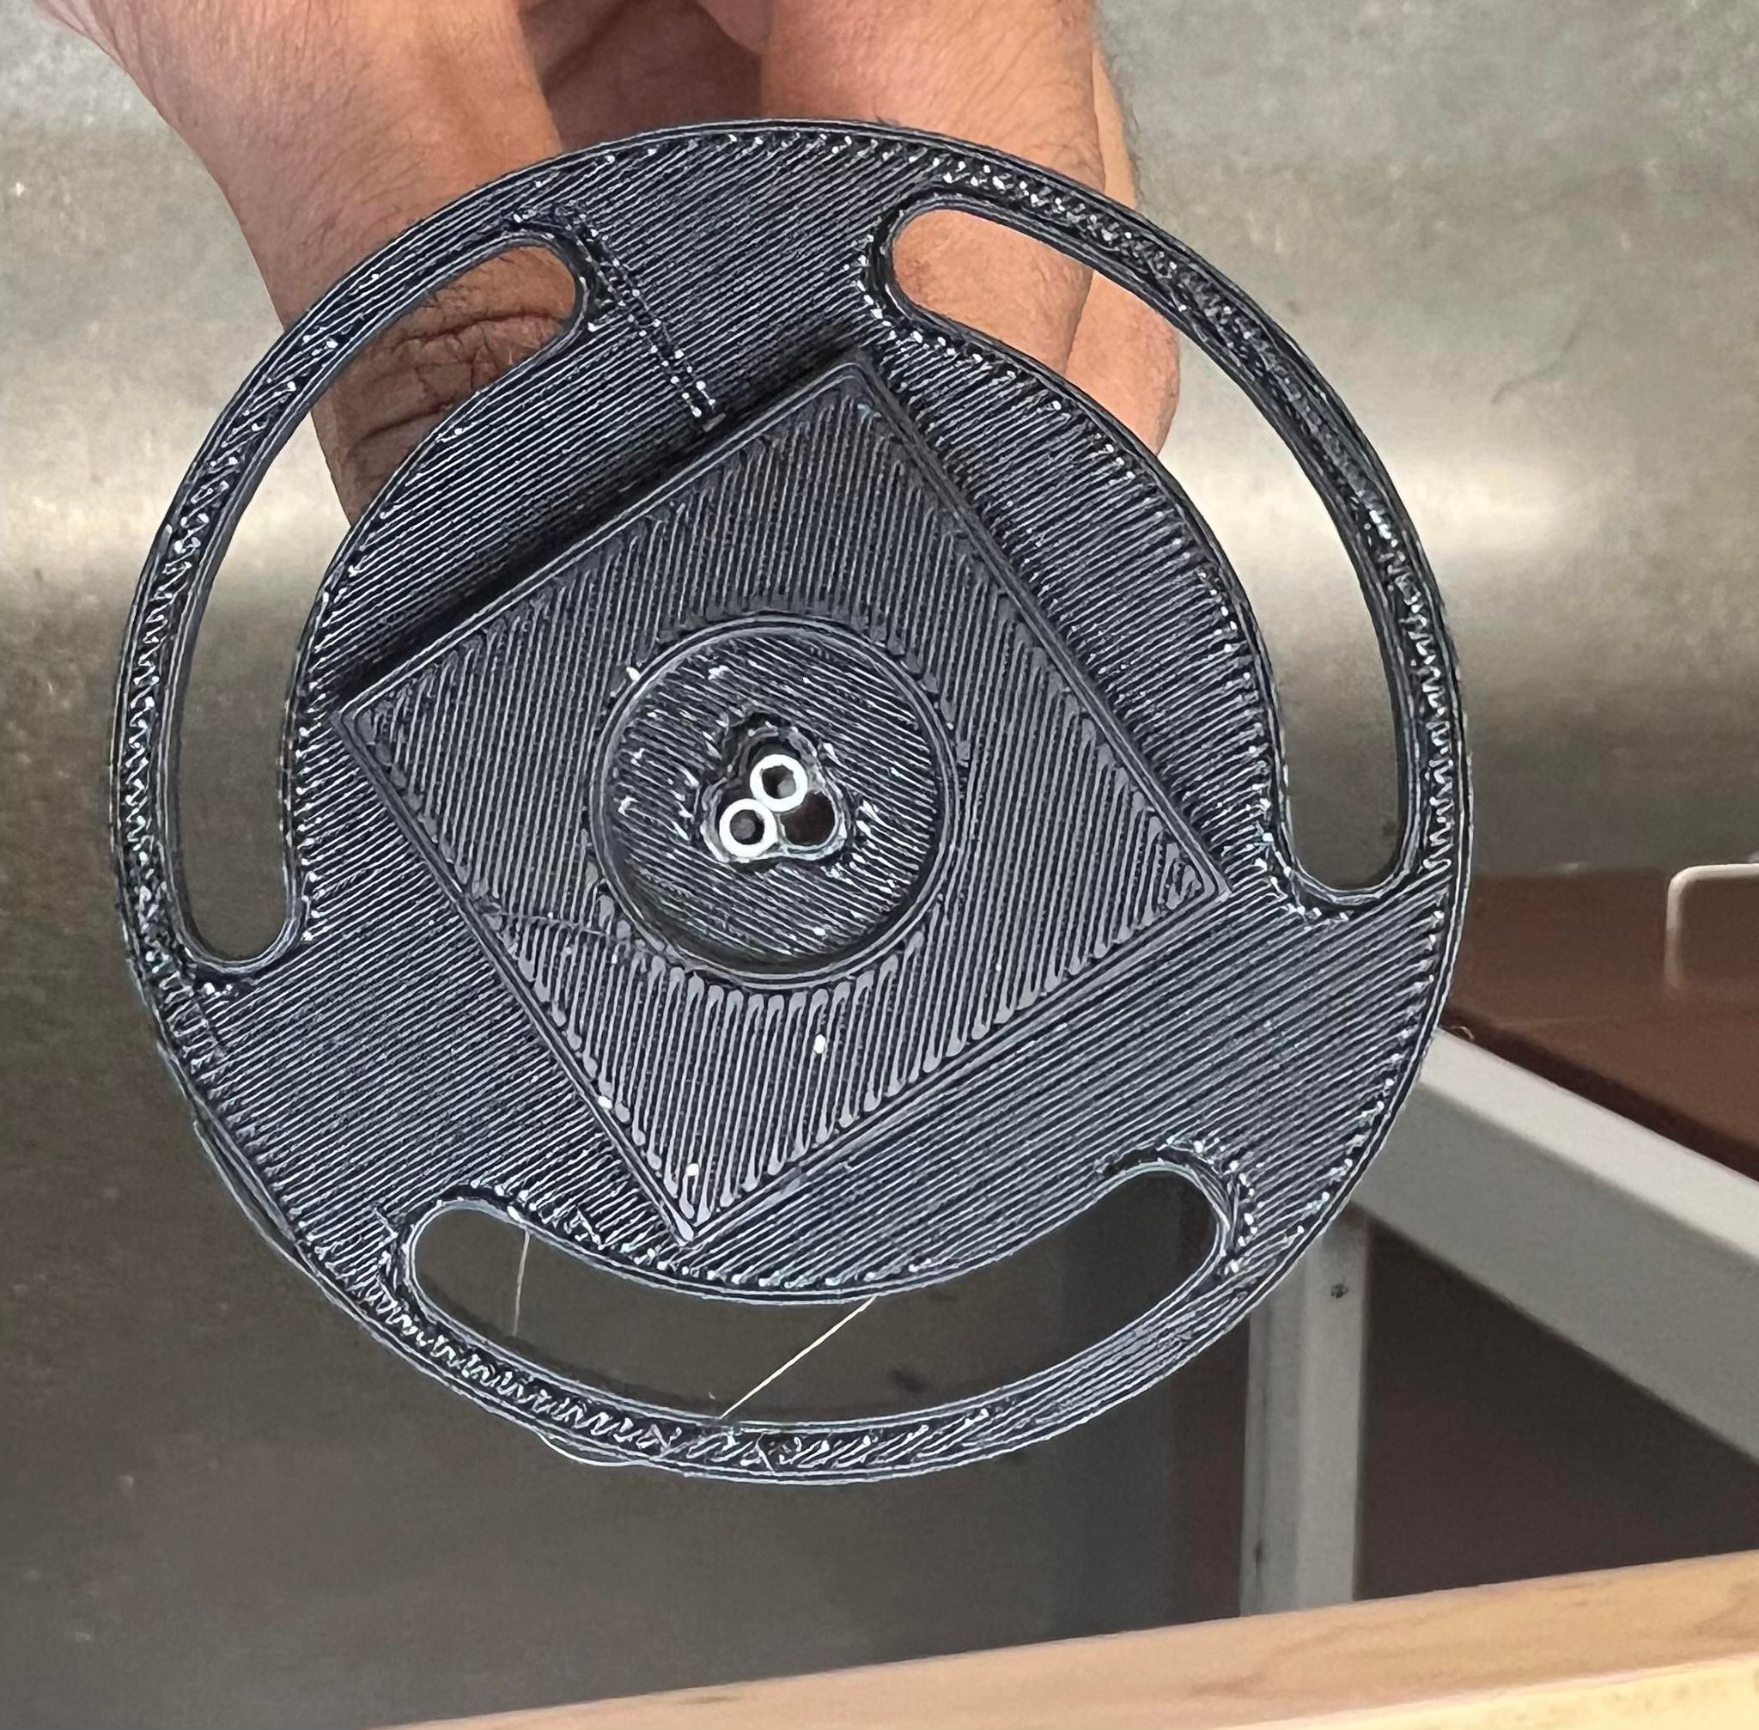

Slide 8
Problems
Washer Method
String needs to be able to freely move
Smaller Springs
Spacing between sleeves
Need to be bigger
Voice Coil Integration?

